Slide 1
The Effectiveness of Logistic Regression and Random Forest Models to Predict Cardiovascular Disease
By: Sang Won Baek
Student ID: 501144120
Supervisor: Uzair Ahmad, Ph.D
Notes:
Hello My name Is Sangwon Baek and the focus of my capstone project is on the effectiveness of logistic regression and random forest models to predict cardiovascular disease.
And my supervisor was Professor Ahmad

Slide 2
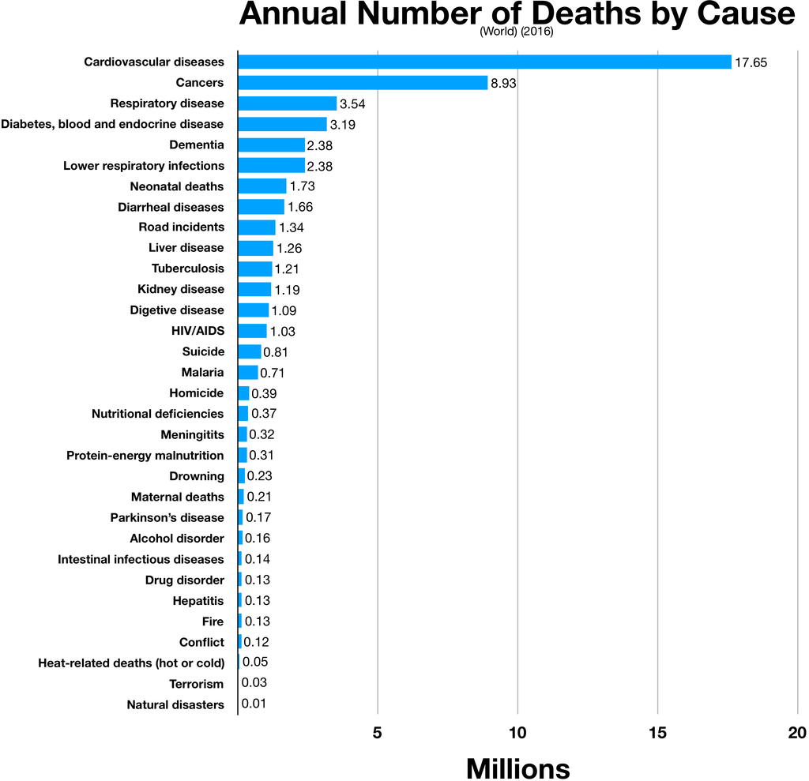
Introduction:
Research Question → how practical are supervised learning techniques in aiding the diagnoses of adverse heart disease events?
Figure 1: Chart of Deaths by Cause
Notes:
According to the World Health Organization, Cardiovascular diseases are the leading cause of death globally, resulting in an estimated 17.8 million deaths per year
One of The United Nations Sustainable Development goals is to reduce incidence of premature mortality from non-communicable diseases by a third by the year 2030.
Therefore, an important step towards achieving this goal is to reduce incidence of cardiovascular disease worldwide.
So based on that end, the research question I posed to answer was:
how practical are supervised learning techniques in aiding the diagnoses of adverse heart disease events?

Slide 3
Dataset and Methodology:
The dataset used for this capstone project is titled “Heart Failure Prediction Dataset” and can be found at https://www.kaggle.com/datasets/fedesoriano/heart-failure-prediction
Import Kaggle dataset and Libraries
Exploratory Data Analysis (EDA) and Visualization
Data Preprocessing and Cleaning
Logistic Regression Model
Random Forest Model
Model Evaluation
Notes:
The dataset used for this capstone project is titled “Heart Failure Prediction Dataset” and can be found on Kaggle.
The dataset is a compilation of 5 different publicly available datasets (from the UCI Machine Learning Repository) which contain common features.
In total, the dataset is comprised of 12 attributes and 918 observations.
The project was completed on google Colab which is a hosted Jupyter notebook and was coded in python.
A quick overview of the approach I took to answer the research question:
First, I had to import the Kaggle dataset and the appropriate libraries needed to complete the project. Several libraries were used for the EDA and data visualization portion of my project. The logistic regression and random forest models were designed and evaluated using the sklearn library.
The exploratory data analysis and visualization phase included several techniques (which will be shown later in the slides) to emphasize certain correlating factors and discover patterns in the data.
The data preprocessing and cleaning phase involved several encoding methods to prepare the data for the models.
Next, the logistic regression and random forest models were built.
And lastly, Multiple evaluation metrics were employed to compare the performance of the models.

Slide 4
Analysis – Attribute Descriptions
Attribute | Definition | DType
Age | Age of the patient (years) | int64
Sex | Sex of the patient (M: Male, F: Female) | object
ChestPainType | Chest pain type (TA: Typical Angina, ATA: Atypical Angina, NAP: Non-Anginal Pain, ASY: Asymptomatic) | object
RestingBP | Resting blood pressure (mm Hg) | int64
Cholesterol | Serum cholesterol (mm/dl) | int64
FastingBS | Fasting blood sugar (1: if FastingBS > 120 mg/dl, 0: otherwise) | int64
RestingECG | Resting electrocardiogram results (Normal: Normal, ST: having ST-T wave abnormality, LVH: showing probable or definite left ventricular hypertrophy by Estes' criteria) | object
MaxHR | Maximum heart rate achieved (Numeric value between 60 and 202) | int64
ExerciseAngina | Exercise-induced angina (Y: Yes, N: No) | object
Oldpeak | Oldpeak = ST (Numeric value measured in depression) | float64
ST_Slope | The slope of the peak exercise ST segment (Up: upsloping, Flat: flat, Down: down sloping) | object
HeartDisease | Target class (1: Heart Disease, 0: Normal) | int64
Notes:
Here’s a brief overview of the different attributes contained in the dataset.
The 12 attributes include: Age, Sex, ChestPainType, Resting Blood Pressure, Cholesterol, Fasting Blood Sugar, RestingECG, Max Heart Rate, ExerciseAngina, Oldpeak, ST_Slope, HeartDisease

Slide 5
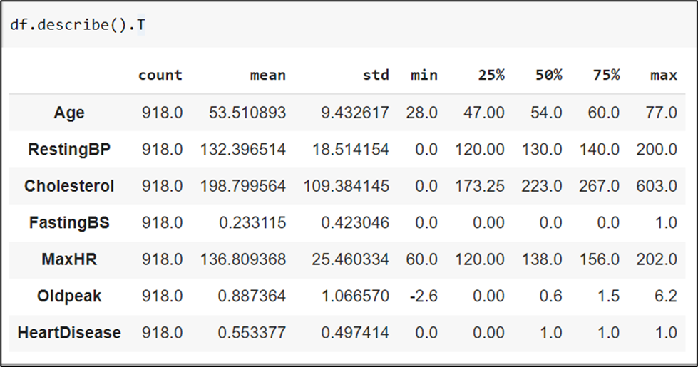
Exploratory Data Analysis and Visualization:
The descriptive statistics of the numerical attributes
Notes:
At the beginning of the exploratory data analysis phase, I looked at the descriptive statistics of the numerical attributes.
Here is a figure from my Jupyter notebook.
It seemed that Age, RestingBP, Cholesterol, and MaxHR may be close to normal distribution. However, more exploratory analysis would be needed to confirm

Slide 6
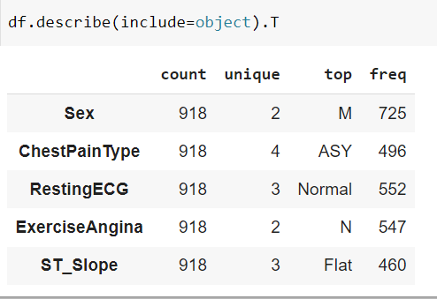
Exploratory Data Analysis and Visualization:
The description of categorical attributes
Notes:
And here’s the description of the categorical attributes.
At initial glance, most of the patients in the dataset are male (725 out of 918) and most patient's FastingBS is not over 120 mg/dl (704 out of 918).

Slide 7
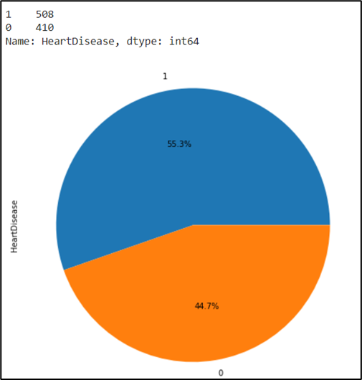
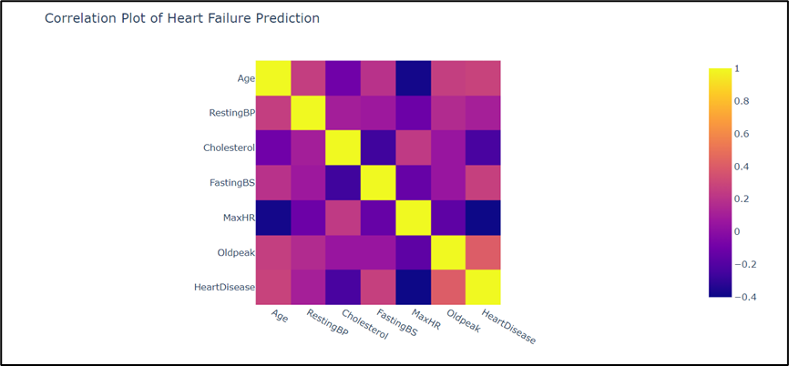
Exploratory Data Analysis and Visualization:
HeartDisease (Target) Variable Exploratory Analysis
Notes:
Next I analyzed the target variable, heart disease.
The dataset contains 508 or 55.3% of patients with heart disease and 410 or 44.7% of patients with no heart disease.
The Correlation plot indicates that heart disease has a negative correlation with max heartrate (-0.4) and a weaker negative correlation with cholesterol (-0.23). On the other hand, heart disease has a positive correlation with Oldpeak (0.4), age (0.28), FastingBS (0.27), and a weaker positive correlation with RestingBP (0.1).

Slide 8
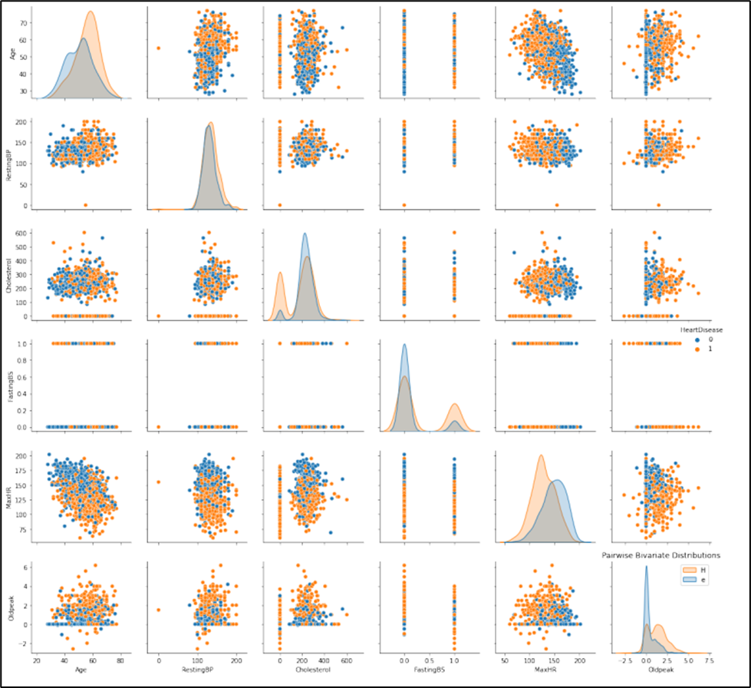
Exploratory Data Analysis and Visualization:
Multiple Pairwise Bivariate Distributions
Notes:
Next I took a look at pairwise bivariate distributions, its hard to see here but the plot shows us that regardless of any other numeric attribute, a patient is more prone to heart disease if they have a lower MaxHR (below 150).

Slide 9
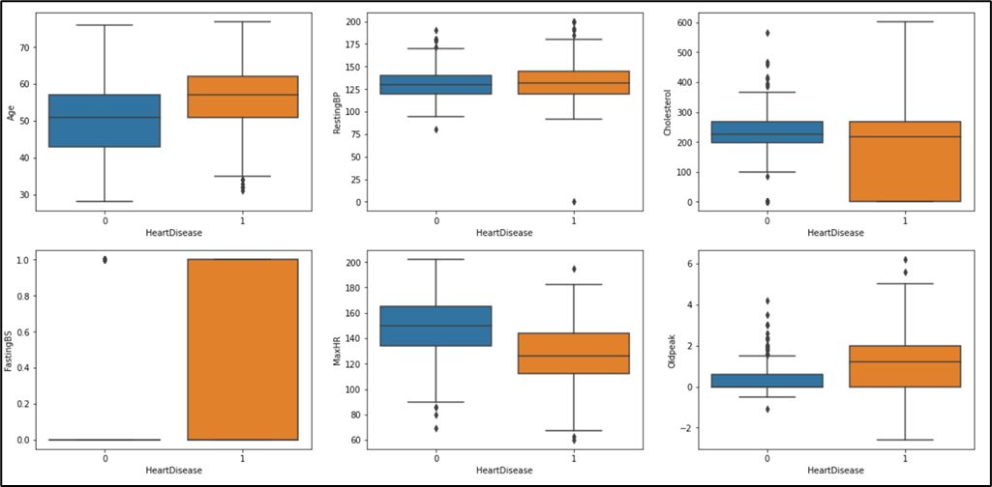
Exploratory Data Analysis and Visualization:
Outlier Analysis
Notes:
Lastly, I took a look at the outliers present in the dataset.
Most of the outliers tend to be concentrated in Oldpeak and cholesterol in patients with no heart disease. However, when looking at the dataset as a whole, the outliers only compose a small percentage of the total data points.

Slide 10
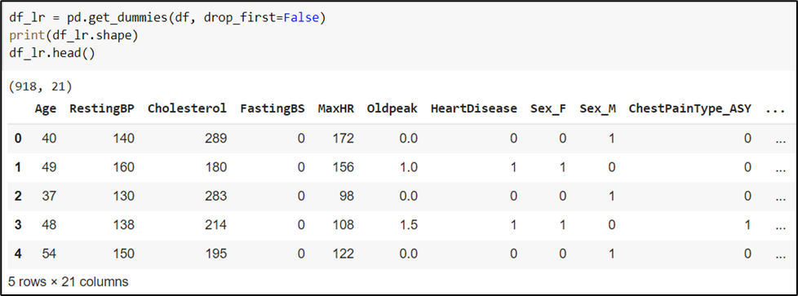
Data Preprocessing:
One-Hot Encoding for Logistic Regression Model:
Notes:
Next, on to the data preprocessing phase:
There was no need to deal with missing data as the dataset contained no missing data.
one-hot encoding was used to prepare the data for the logistic regression model as the categorical data had no ordinal value.
This process converted the categorical data into numerical data to ensure better prediction from the logistic regression model.

Slide 11
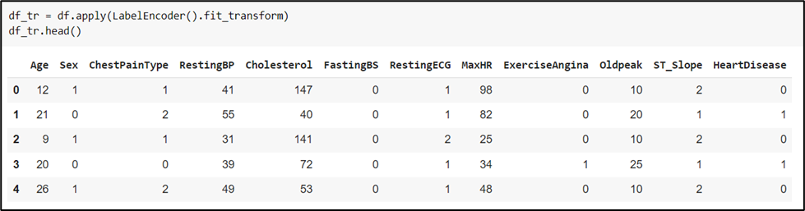
Data Preprocessing:
Label Encoding for Random Forest Model:
Notes:
Label encoding was performed to prepare the data for the random forest model.
Where in, each value in the categorical columns were assigned a number.
[As random forest models are compatible with categorical values, label encoding was performed to use less disk space. ]

Slide 12
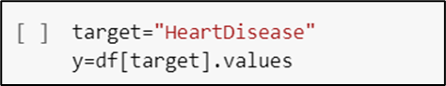
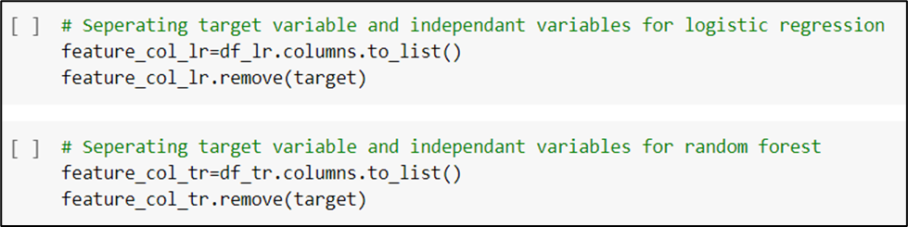
Data Preprocessing:
Setting HeartDisease as the Target attribute
Separating the Target variable and Independent variables for both models
Notes:
The last step of data preprocessing involved setting the y (target) variable as the HeartDisease attribute and to separate the target variable and the independent variables for the logistic regression and random forest models.

Slide 13
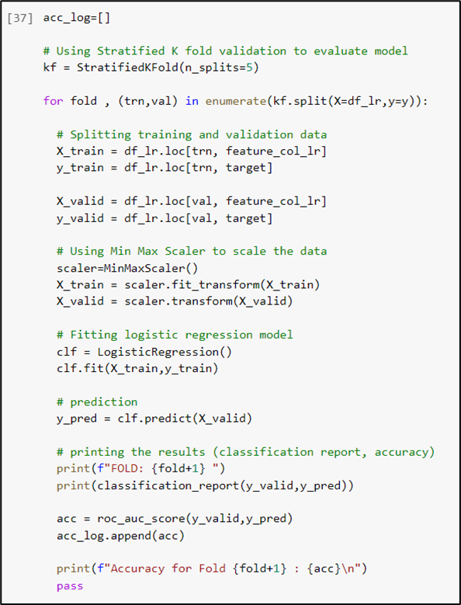
Logistic Regression Model using Stratified K (5) Fold Validation:
Notes:
In preparation for the logistic regression model, min max scaler was utilized to properly normalize the data.
Then the SkLearn Library was used to train and fit the logistic regression model. Stratified 5-fold validation was used to evaluate the model as the binary target variable was unbalanced (55.3% heart disease vs 44.7% normal).

Slide 14
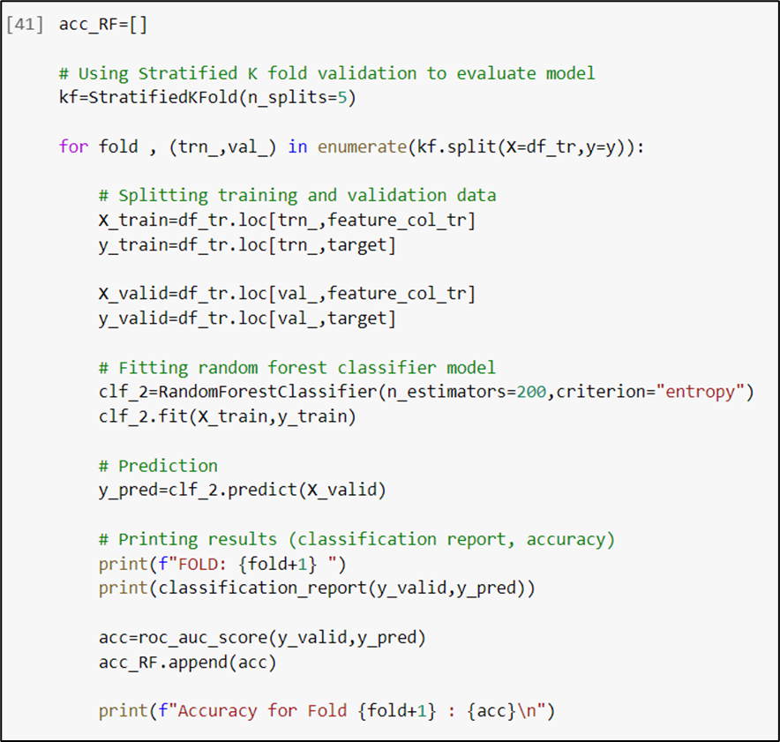
Random Forest Model using Stratified K (5) Fold Validation:
Notes:
For the Random Forest Model, the Sklearn library was once again used to train and evaluate the model and Stratified 5-fold validation was used to evaluate the model.

Slide 15
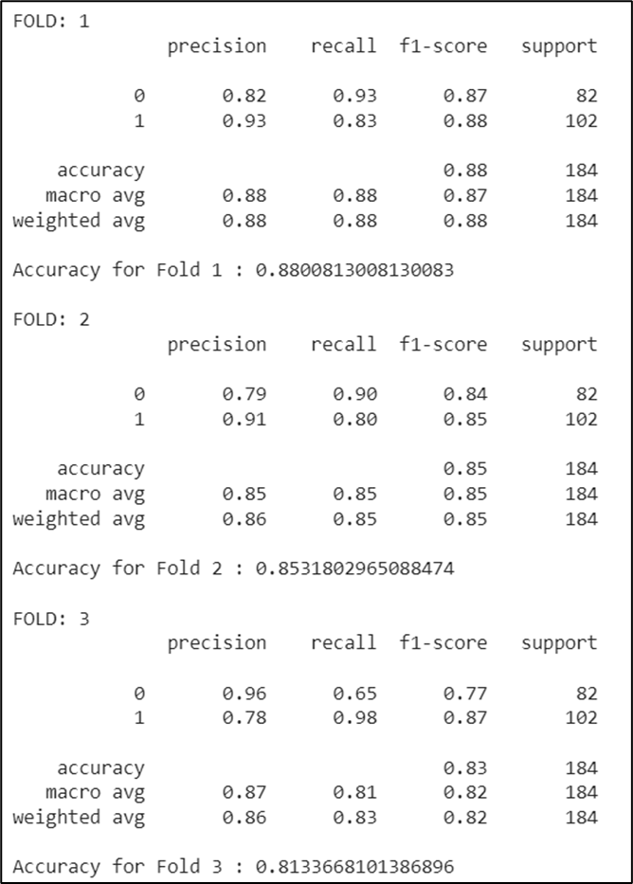
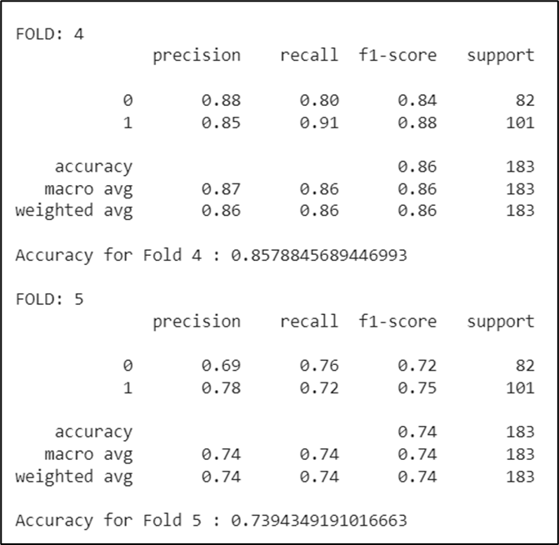
Results of the Logistic Regression Model:
Classification Report and Accuracy
Notes:
First we will take a look at the classification reports of the logistic regression models.
The average accuracy across all 5 folds were 82.8%. In terms of precision, out of all the patients that the model predicted to have heart disease, 85% actually did. Therefore, the high precision indicates a relatively low false positive rate. In terms of recall, out of all the patients that actually had heart disease, the model correctly predicted this outcome for 84.8% of those patients. Therefore, the high recall indicates a relatively low false negative rate.

Slide 16
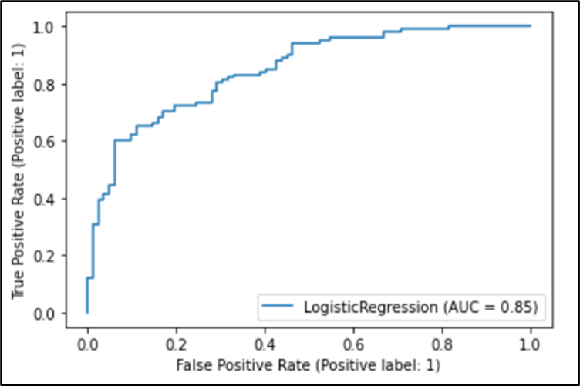
Results of the Logistic Regression Model:
ROC (Receiver Operator Characteristic) Curve
Notes:
The ROC Curve measures the trade off between sensitivity and specificity. The AUC (Area Under the Curve) is a general measure of the model’s predictive accuracy. The logistic regression model has an AUC of 0.85. Therefore, the logistic regression model has relatively high predictive accuracy.

Slide 17
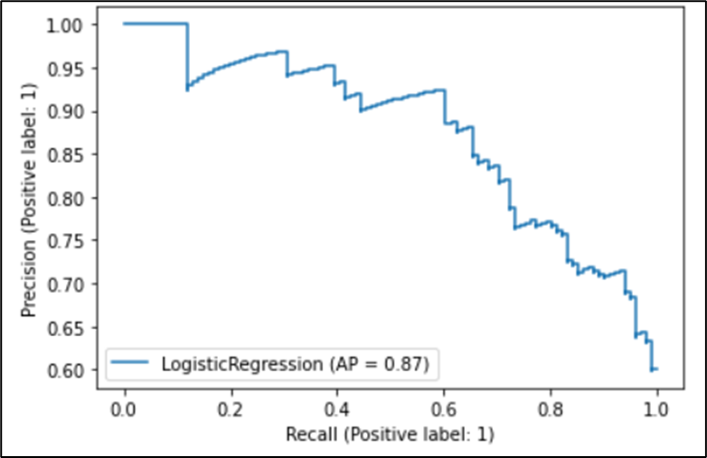
Results of the Logistic Regression Model:
Precision-Recall Curve
Notes:
The Precision-Recall Curve measures the trade off between precision and recall at different thresholds. The AP (the average precision) is a general measure of the model’s precision and recall scores. The logistic regression model has an AP of 0.87. Therefore, the logistic regression model has a relatively high precision and high recall score.

Slide 18
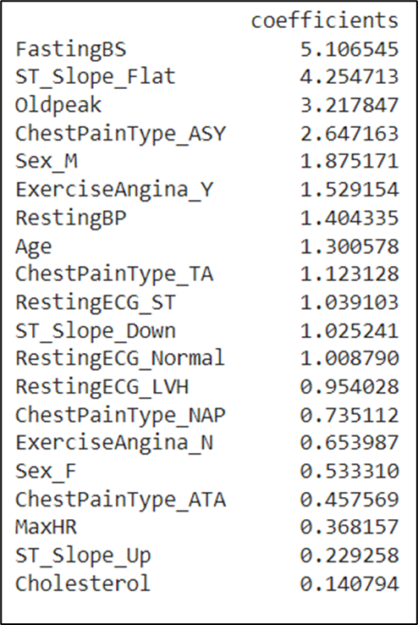
Results of the Logistic Regression Model:
Logistic Regression Coefficients
Notes:
The coefficients were obtained through exponentiating the log odd coefficients.
The Coefficients indicate that FastingBS (5.1), ST_Slope_Flat (4.3), Oldpeak (3.2), and ChestPainType_ASY (2.6) are the attributes that most influence the diagnosis of heart disease.

Slide 19
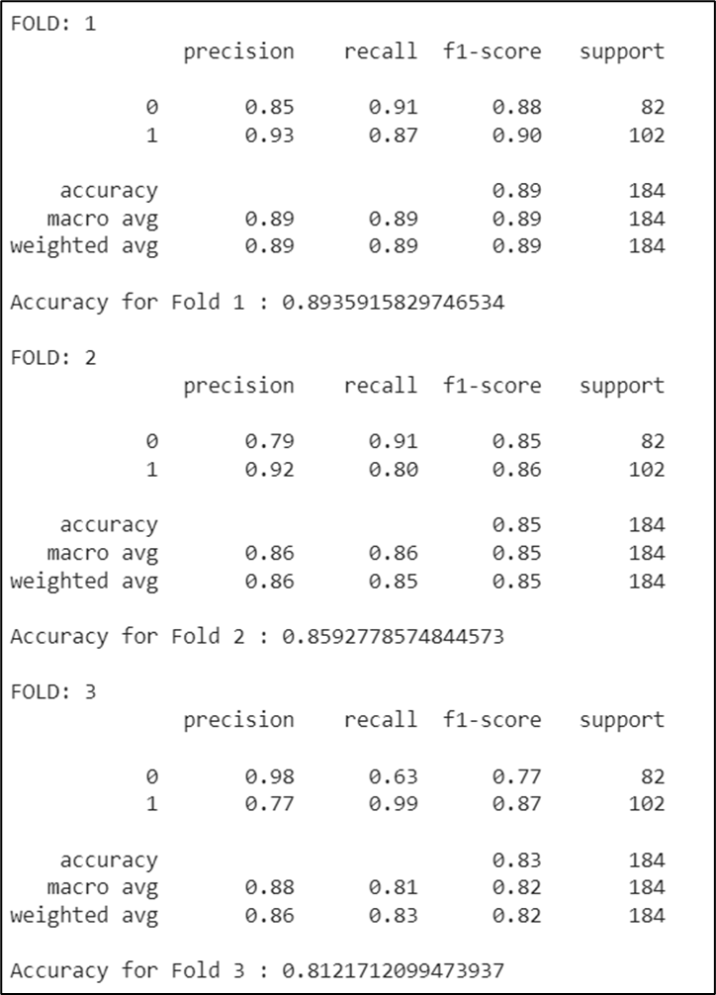
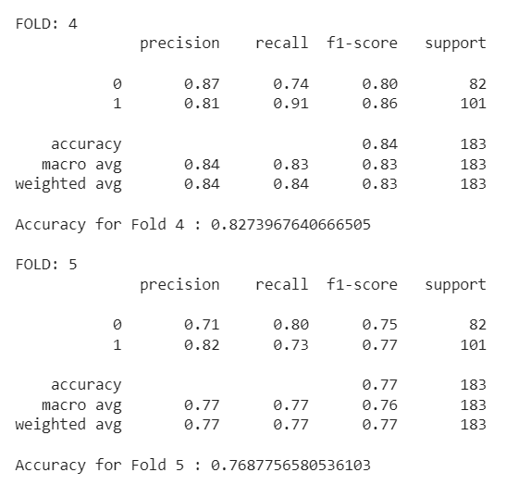
Results of the Random Forest Model:
Classification Report and Accuracy
Notes:
Next, Ill talk about the results of the random forest model.
The average accuracy across all 5 folds were 83.23%. In terms of precision, out of all the patients that the model predicted to have heart disease, 85% actually did. And In terms of recall, out of all the patients that actually had heart disease, the model correctly predicted this outcome for 86% of those patients.

Slide 20
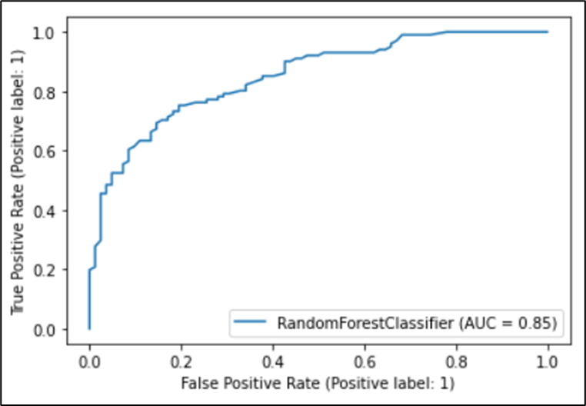
Results of the Random Forest Model:
ROC (Receiver Operator Characteristic) Curve:
Notes:
The random forest model has an AUC of 0.85. Therefore, as explained before, the model has relatively high predictive accuracy.

Slide 21
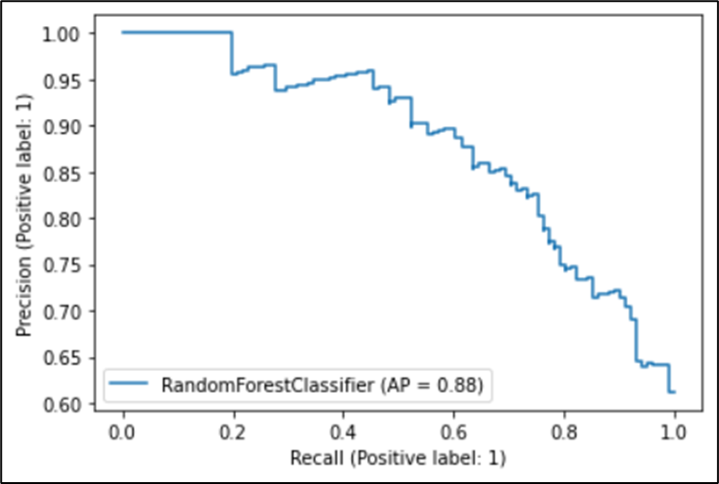
Results of the Random Forest Model:
Precision-Recall Curve
Notes:
The Random Forest model has an AP of 0.88. Therefore, the model has a relatively high precision and high recall score as well.

Slide 22
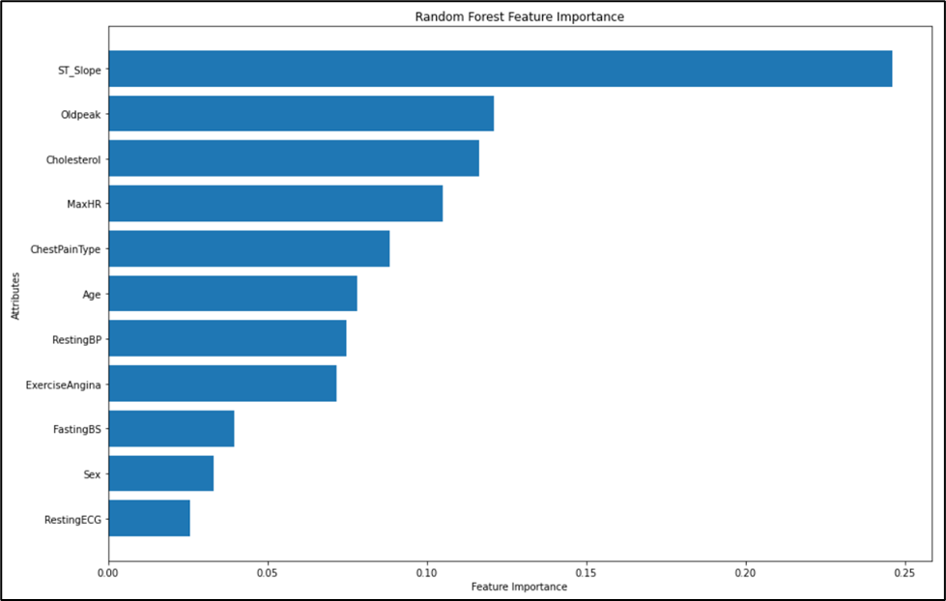
Results of the Random Forest Model:
Random Forest Feature Importance
Notes:
The random forest model shows that ST_Slope, Oldpeak, and Cholesterol are the top three most important features when predicting the patient’s heart disease status.

Slide 23
Comparison between Logistic Regression Model and Random Forest Model:
Both the Models had very similar performance for most evaluation metrics
 | Logistic Regression | Random Forest
Accuracy | 82.88% | 83.23%
Precision | 85% | 85%
Recall | 84.8% | 86%
ROC Curve AUC | 0.85 | 0.85
Precision-Recall Curve AP | 0.87 | 0.88
Notes:
Both the Models had very similar performance for most evaluation metrics.
with the random forest model slightly edging out the logistic regression model in accuracy, recall, and the precision recall curve AP
when comparing the logistic regression coefficients and the random forest feature importance. Both models agree that ST_Slope and Oldpeak are highly relevant in the diagnosis of Heart disease.

Slide 24
Conclusion:
Both Models performed similarly
The Results have shown that cardiovascular disease prevalence can be predicted with the use of simple machine learning algorithms such as logistic regression and random forest models
Notes:
So overall, both Models performed very similarly.
as the evaluation metrics are so similar across both models, it may benefit from increasing the number of folds, experimenting with other aspects of the model to improve model performance or to compare both the models with a different tree-based model (such as decision tree classifier or XGBoost).
In conclusion, this capstone project has shown that cardiovascular disease prevalence can be predicted with the use of simple supervised learning algorithms such as logistic regression and random forest models as both the models performed well.
I believe the continuation of this field of research is pivotal towards introducing the benefits of machine learning algorithms in the use of healthcare industries. The next steps of research should include increasing the complexity and optimization of the algorithms to increase their efficiency and efficacy. The use of live data would also benefit to further test the real-world effectiveness of the models.

Slide 25
References:
fedesoriano. (September 2021). Heart Failure Prediction Dataset. Retrieved [May 15, 2022] from https://www.kaggle.com/fedesoriano/heart-failure- prediction.
Figure 1: Figure by Wikideas1 - Own work https://ourworldindata.org/what-does- the-world-die-from, CC BY-SA 4.0, https://commons.wikimedia.org/w/index.php?curid=78229514
Kaptoge, S., Pennells, L., De Bacquer, D., Cooney, M. T., Kavousi, M., Stevens, G., . . . Altay, S. (2019). World health organization cardiovascular disease risk charts: Revised models to estimate risk in 21 global regions. The Lancet Global Health, 7(10), e1332-e1345.
The source code for the capstone project can be viewed on GitHub at https://github.com/swb1113/CIND820/blob/main/CIND820_Final_Results.ipynb

